Slide 1
SCHEDULING SCRIPTS

Slide 2
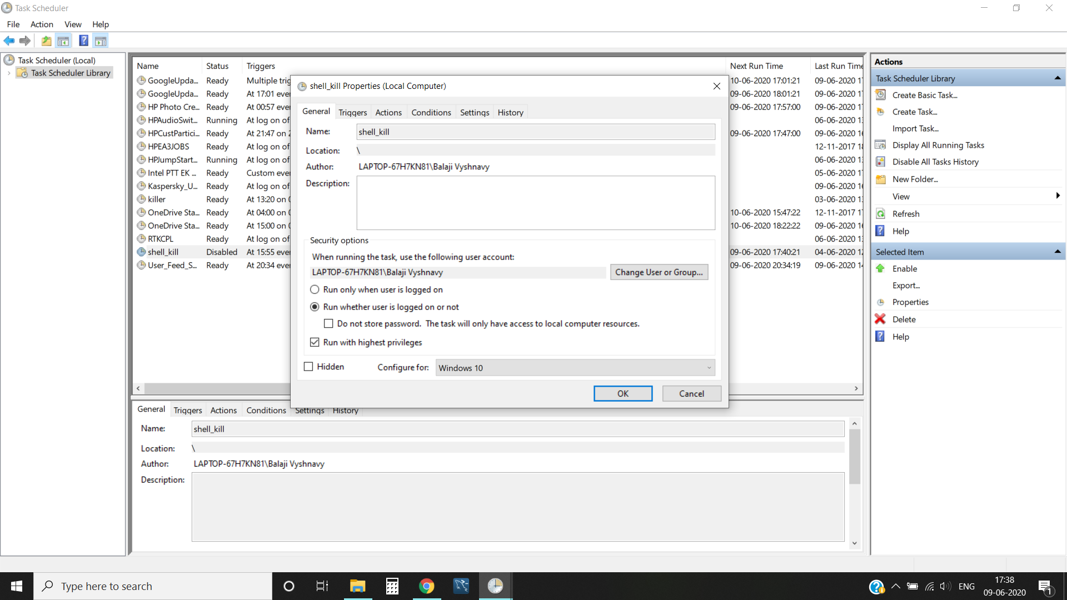
Go to create new task and apply following settings described in following slides in Task
Scheduler.

Slide 3
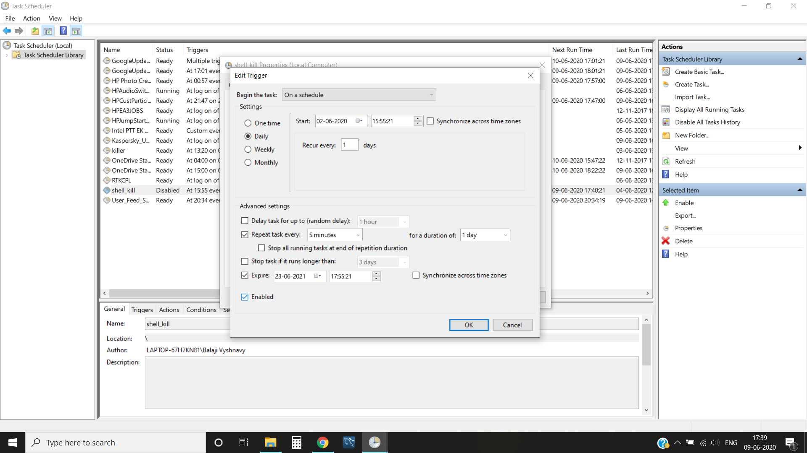
Schedule immitating below shows settings.

Slide 4
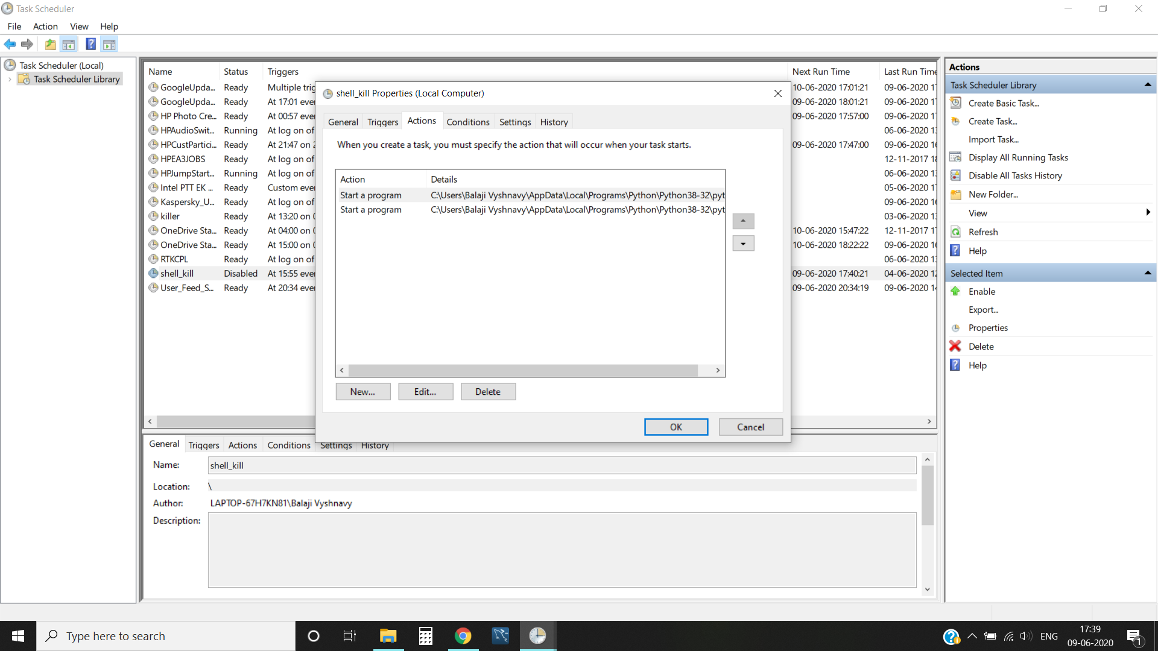
Add these two tasks. -> inspector.py ->surveillance.py

Slide 5
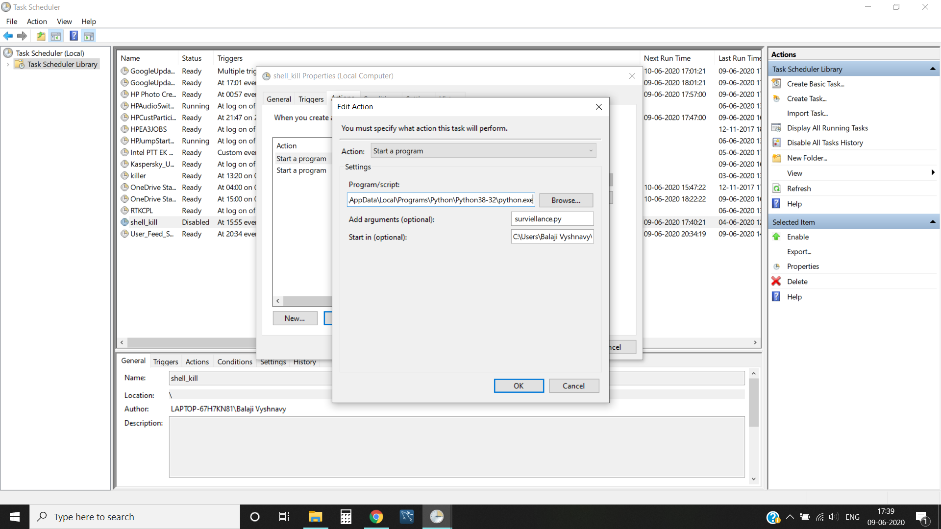
Add python executable to the script section.
Add the name of script to the arguments field.
Add the location of the script to the start in field.

Slide 6
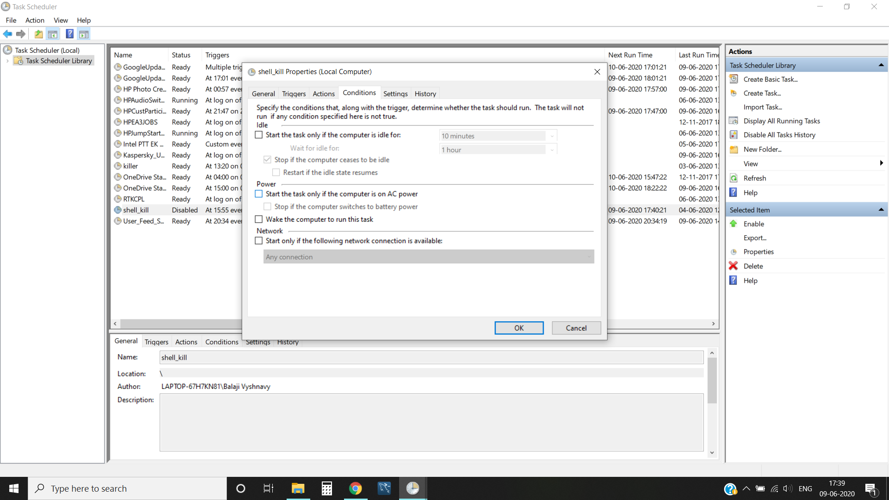
Uncheck following fields

Slide 7
Thank You

